Slide 1
Data Visualisation dimple.js
James.Fennell@lit.ie

Slide 2
Dimple.js What is it?
Dimple is a library built on top of D3
It has a gentle learning curve
It exposes D3 objects which supports increased flexibility
http://dimplejs.org/
https://github.com/pmsi-alignalytics/dimple/

Slide 3
Visual Technology Tech Stack
Speed
Flexibility
Raw, Chartio | Scratch
NVD3, Dimple Rickshaw | Python
D3.js | C, C++
WebGL, Canvas, SVG | Assembly
Raw and Chartio
Submit data and they will produce a selection of charts
Fast but no flexibility
NVD3, Dimple., Rickshaw
Libraries built on D3
Each specialise in and simplify common visualisation tasks in D3
D3.js
Allows binding of data to SVG and HTML elements
Built on Javascript, HTML, SVG and CSS
WebGL, Canvas, SVG
Low level graphics
Flexible, Efficient, Performant but hard to develop with
Notes:
Rickshaw specialises in time series
Other libraries specialise in maps/cart

Slide 4
Dimple.js - Tutorial
Download the sample project and from moodle
Investigate the World Cup data set

Slide 5
Dimple.js - Tutorial
Which chart type would be suitable for presenting attendance per year?
Bar Chart
Table
Line Chart
Map
Small Multiples
Scatter Plot
Draw a Sketch!

Slide 6
Types of Charts
Bar Chart
A bar chart is a good choice. Bar charts can show relative numbers, like percentages, or allow compare absolute values of categorical data
Table
A table would work! Tables are excellent if exact numbers need to be looked up by the reader.
Line Chart
A line chart is a great choice! Line charts are particularly good for showing changes over time.
Map
A map is good choice for linking data to geographical locations.
Small Multiples
Small multiples could work for the data as well. Small multiples reduce cognitive overload.
Scatter Plot
A scatterplot is a great choice for the data! Scatterplots are suited for showing the relationship between two variables.

Slide 7
Data Visualisation Sketching
There is no “right answer”
There is a reasoning process.
back up your decision making with good theory
Pick a few different chart types and see how effective they are at conveying relationships in your data
Use the chart on the next slide as a starting point for your decision making

Slide 8
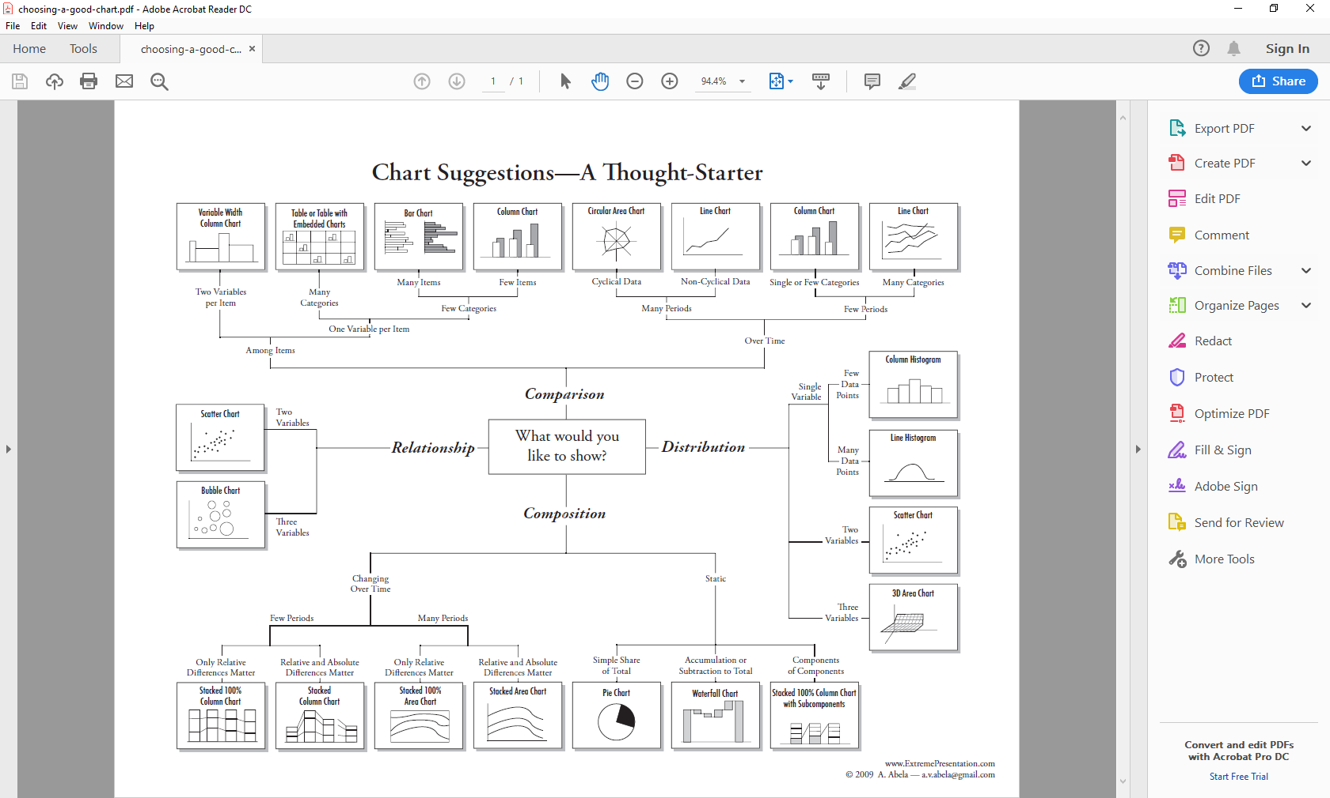
Data Visualisation Sketching

Slide 9
JavaScript and CORS
In some cases, you can view local HTML files directly in your web browser.
However, some browsers have restrictions that prevent them from loading local files via JavaScript, for security reasons.
That means if your D3 code is trying to pull in any external datafiles (like CSVs or JSON), it will fail with no good explanation.
This isn’t D3’s fault; it’s a browser feature that prevents loading of scripts and other external files from third-party, untrusted websites.
This security restriction is formally called CORS (Cross-Origin Resource Sharing)

Slide 10
CORS workaround
CORS can be switched off in the browser
A more secure way around this is to start a local HTTP server that will hist your HTML and JavaScript code
Navigate to the directory that contains all of the files and then type in the command line.
python -m SimpleHTTPServer (Python 2)
python -m http.server (Python 3)
If you type localhost:8000 into the address bar of your browser, then you should see the files that you can display in the web page.

Slide 11
Sample dimple chart
Download the dimple project from moodle
Open the basic_charts.html in an editor

Slide 12
Sample dimple chart
When you first load the page the chart should display
Now open the console (F12) and reload the page
The debugger will now stop execution before the D3 code executes
We will now inspect each object as we create it

Slide 13
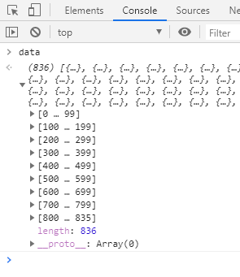
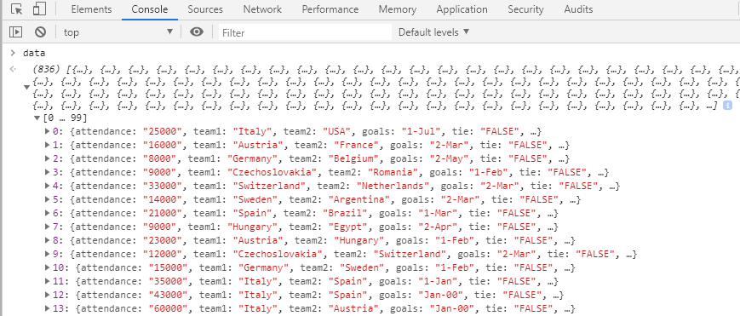
Sample dimple chart
We check the data object on its own
We can see that it is an array with 836 values
When we inspect the vaues we can see that each one is a World Cup Match Object

Slide 14
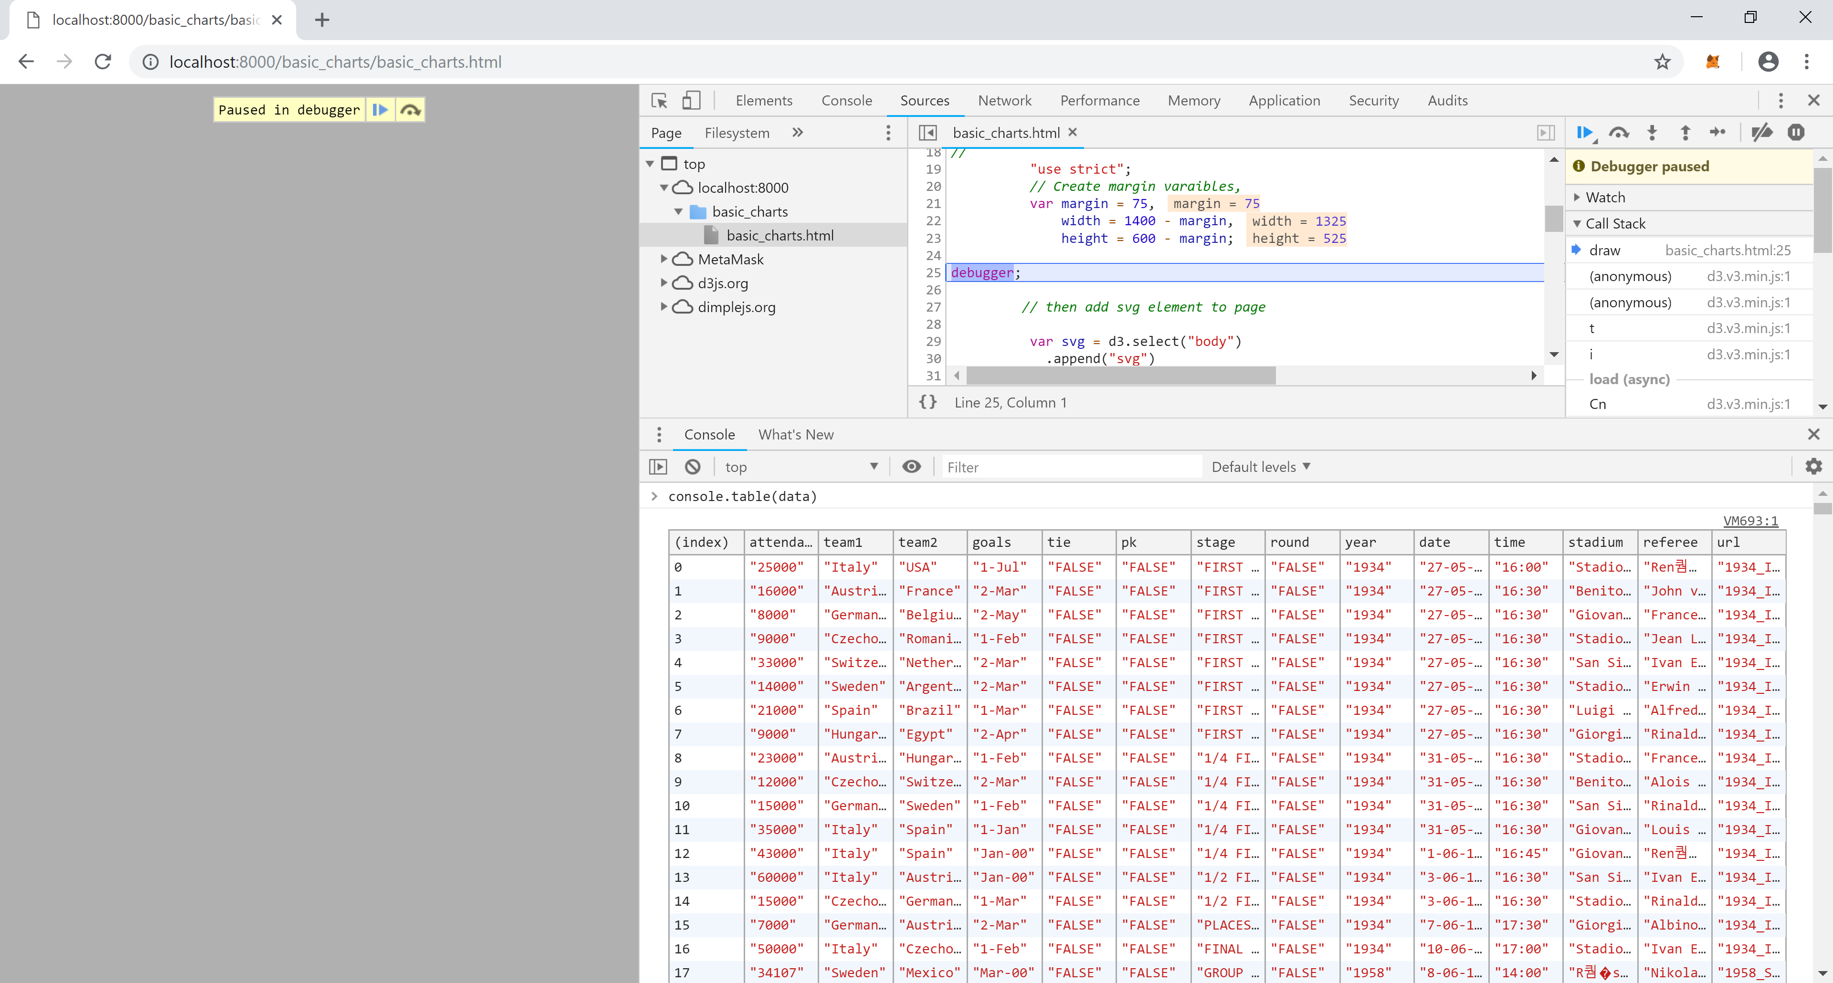
Sample dimple chart
First check that the data successfully loaded
Use pass the data object to console.table
This will print out the data in a clean
table format

Slide 15
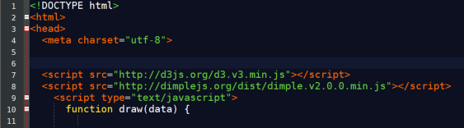
Loading Dimple
D3 is always loaded before dimple
This is because dimple is built on top of D3/references D3 functions
Here we are referencing the javascript files that are available on the web
if you do not have web access you will have to reference the files in your projects file structure as we did in the first tutorial

Slide 16
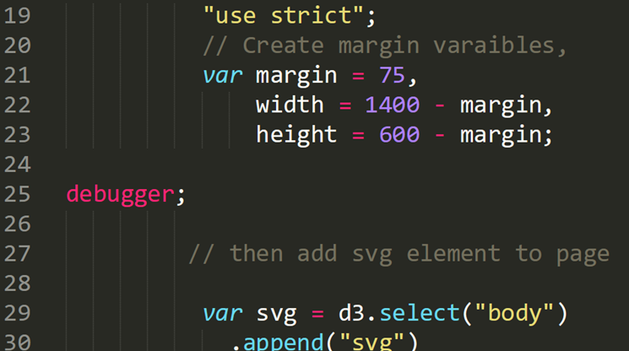
Sample dimple chart
Add a debug line in the code after the data is loaded and the draw function is called
Add more debug lines after every var declaration
As the code execution stops
read the comments
associated documentation
And inspect the elements in the console
to understand what is happening at that line

Slide 17
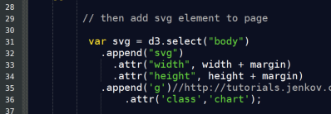
Sample dimple chart
This is standard D3 code to add am SVG to the HTML page
append an svg tag to the body
Set the width and height of the SVG
Append a ‘g’ tag to group the data
This groups the SVG into a single element
Similar to div tags in HTML
See the tutorial referenced in the code
And set the CSS class to Chart

Slide 18
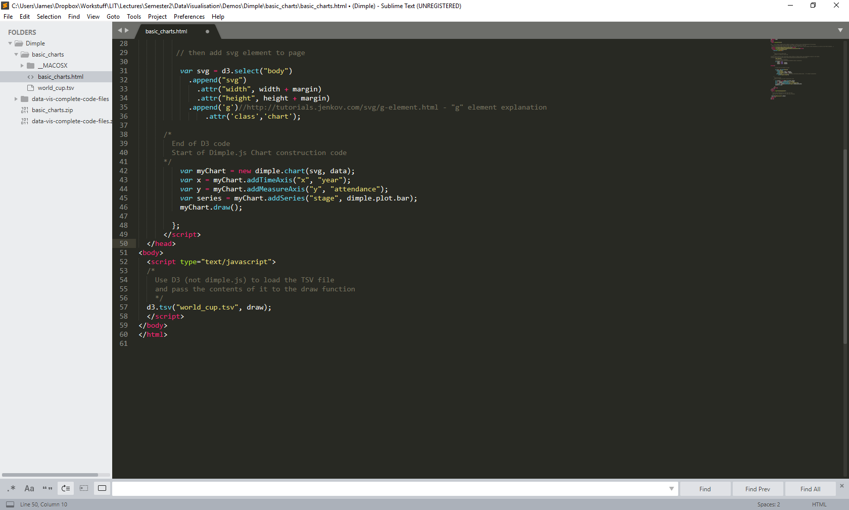
Sample dimple chart
These 5 lines of code build a pretty slick bar chart, with tool-tips and dynamic gridlines.
That would take a minimum of 30 lines of D3
The addition and editing of chart elements is easy to understand
nearly readable by a layperson

Slide 19
Sample dimple chart Line by line
This line creates the dimple chart object
First element is a D3 selection which returns the previously created SVG
Second element is a Javascript object representing the data
Sets the charts x-axis to be a continuous time series
set to correspond to the year column in our data
Sets charts the y-axis to be a measure
corresponds to the attendance column
Specifies that we want a bar chart
Change stage to null – what happens?
Draws the chart we have built!
1
2
3
4
5

Slide 20
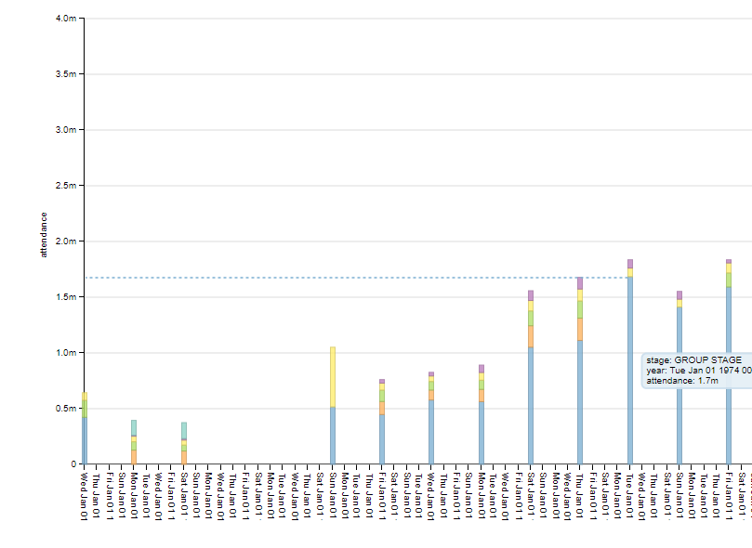
Features of Dimple
The colours are nice pastelles
The chart generates handy tooltips
Check the details….
The scales are auto generated to be optimum

Slide 21
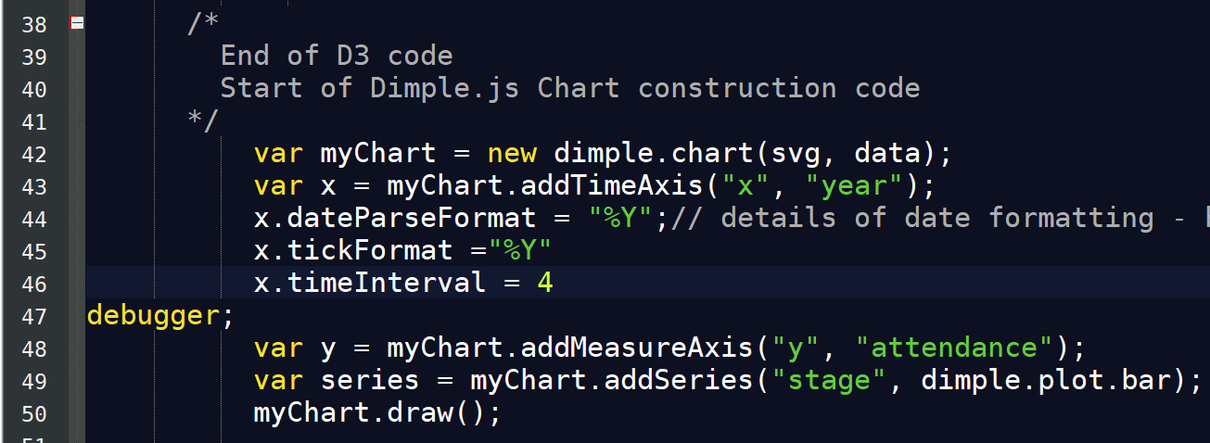
Formatting of Dates
We can tidy up the x axis by
formatting the format the way the dates are parsed to only look at the year
Setting each tick to be a year and not a particular date
Changing the intervals to be every four years rather than every year

Slide 22
BarChart Strengths vs Weaknesses
Good
Easy to see years WC was not held
Rigid and regular spacing
Easy to compare values
Bad
BarCharts are typically better for categorical data on the x axis
Because of the quantitative and serial way years occur there is a lot of empty space

Slide 23
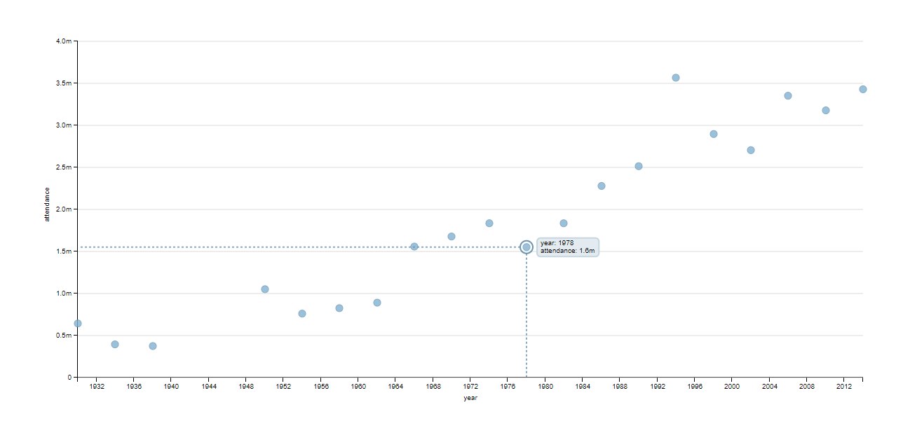
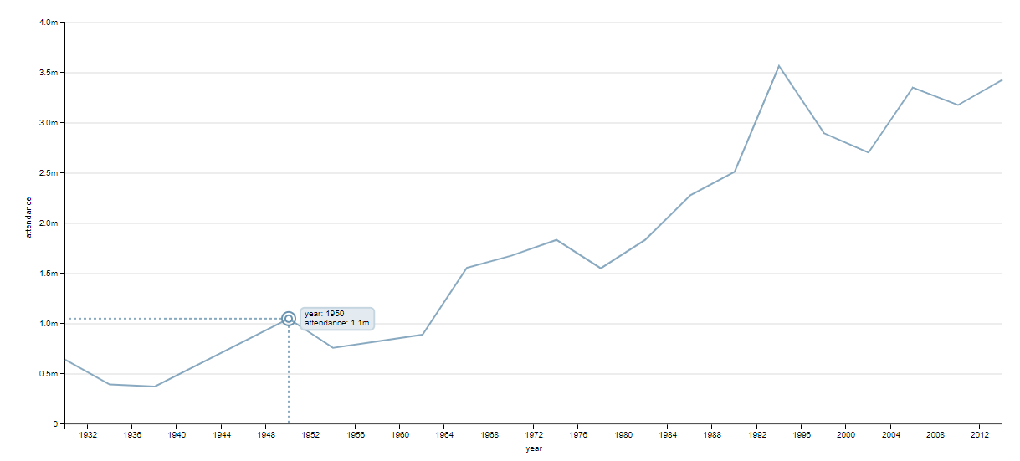
Change it to a scatterplot or lineplot!

Slide 24
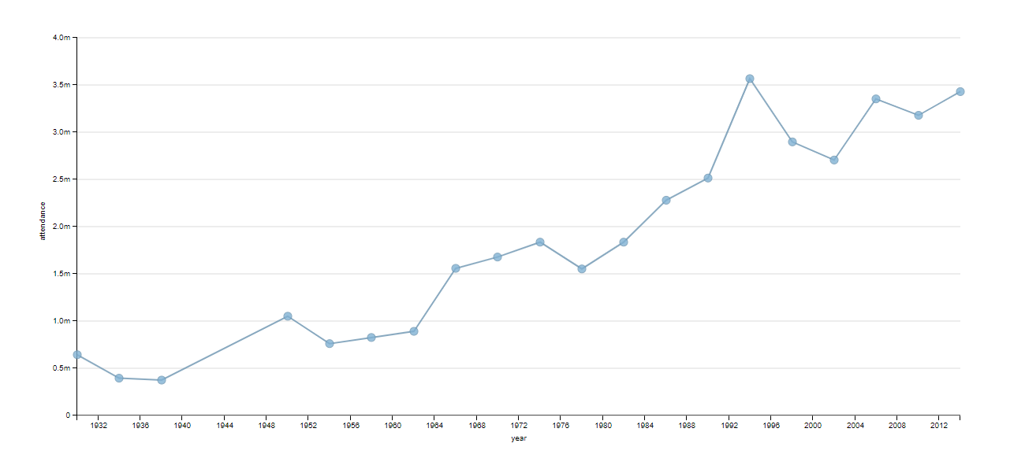
Best of both Worlds Use scatterplot AND lineplot!

Slide 25
Line Plot + Scatter Plot Colour Circles
The combination of lineplot and scatter plot works well
Easy to see years WC was not held
Rigid and regular spacing
Easy to compare values
Can determine the serial poassing of time without lots of empty space
If we colour the bubbles differently they individual; world cups will stand out more and the above benefits will be emphasised even more

Slide 26
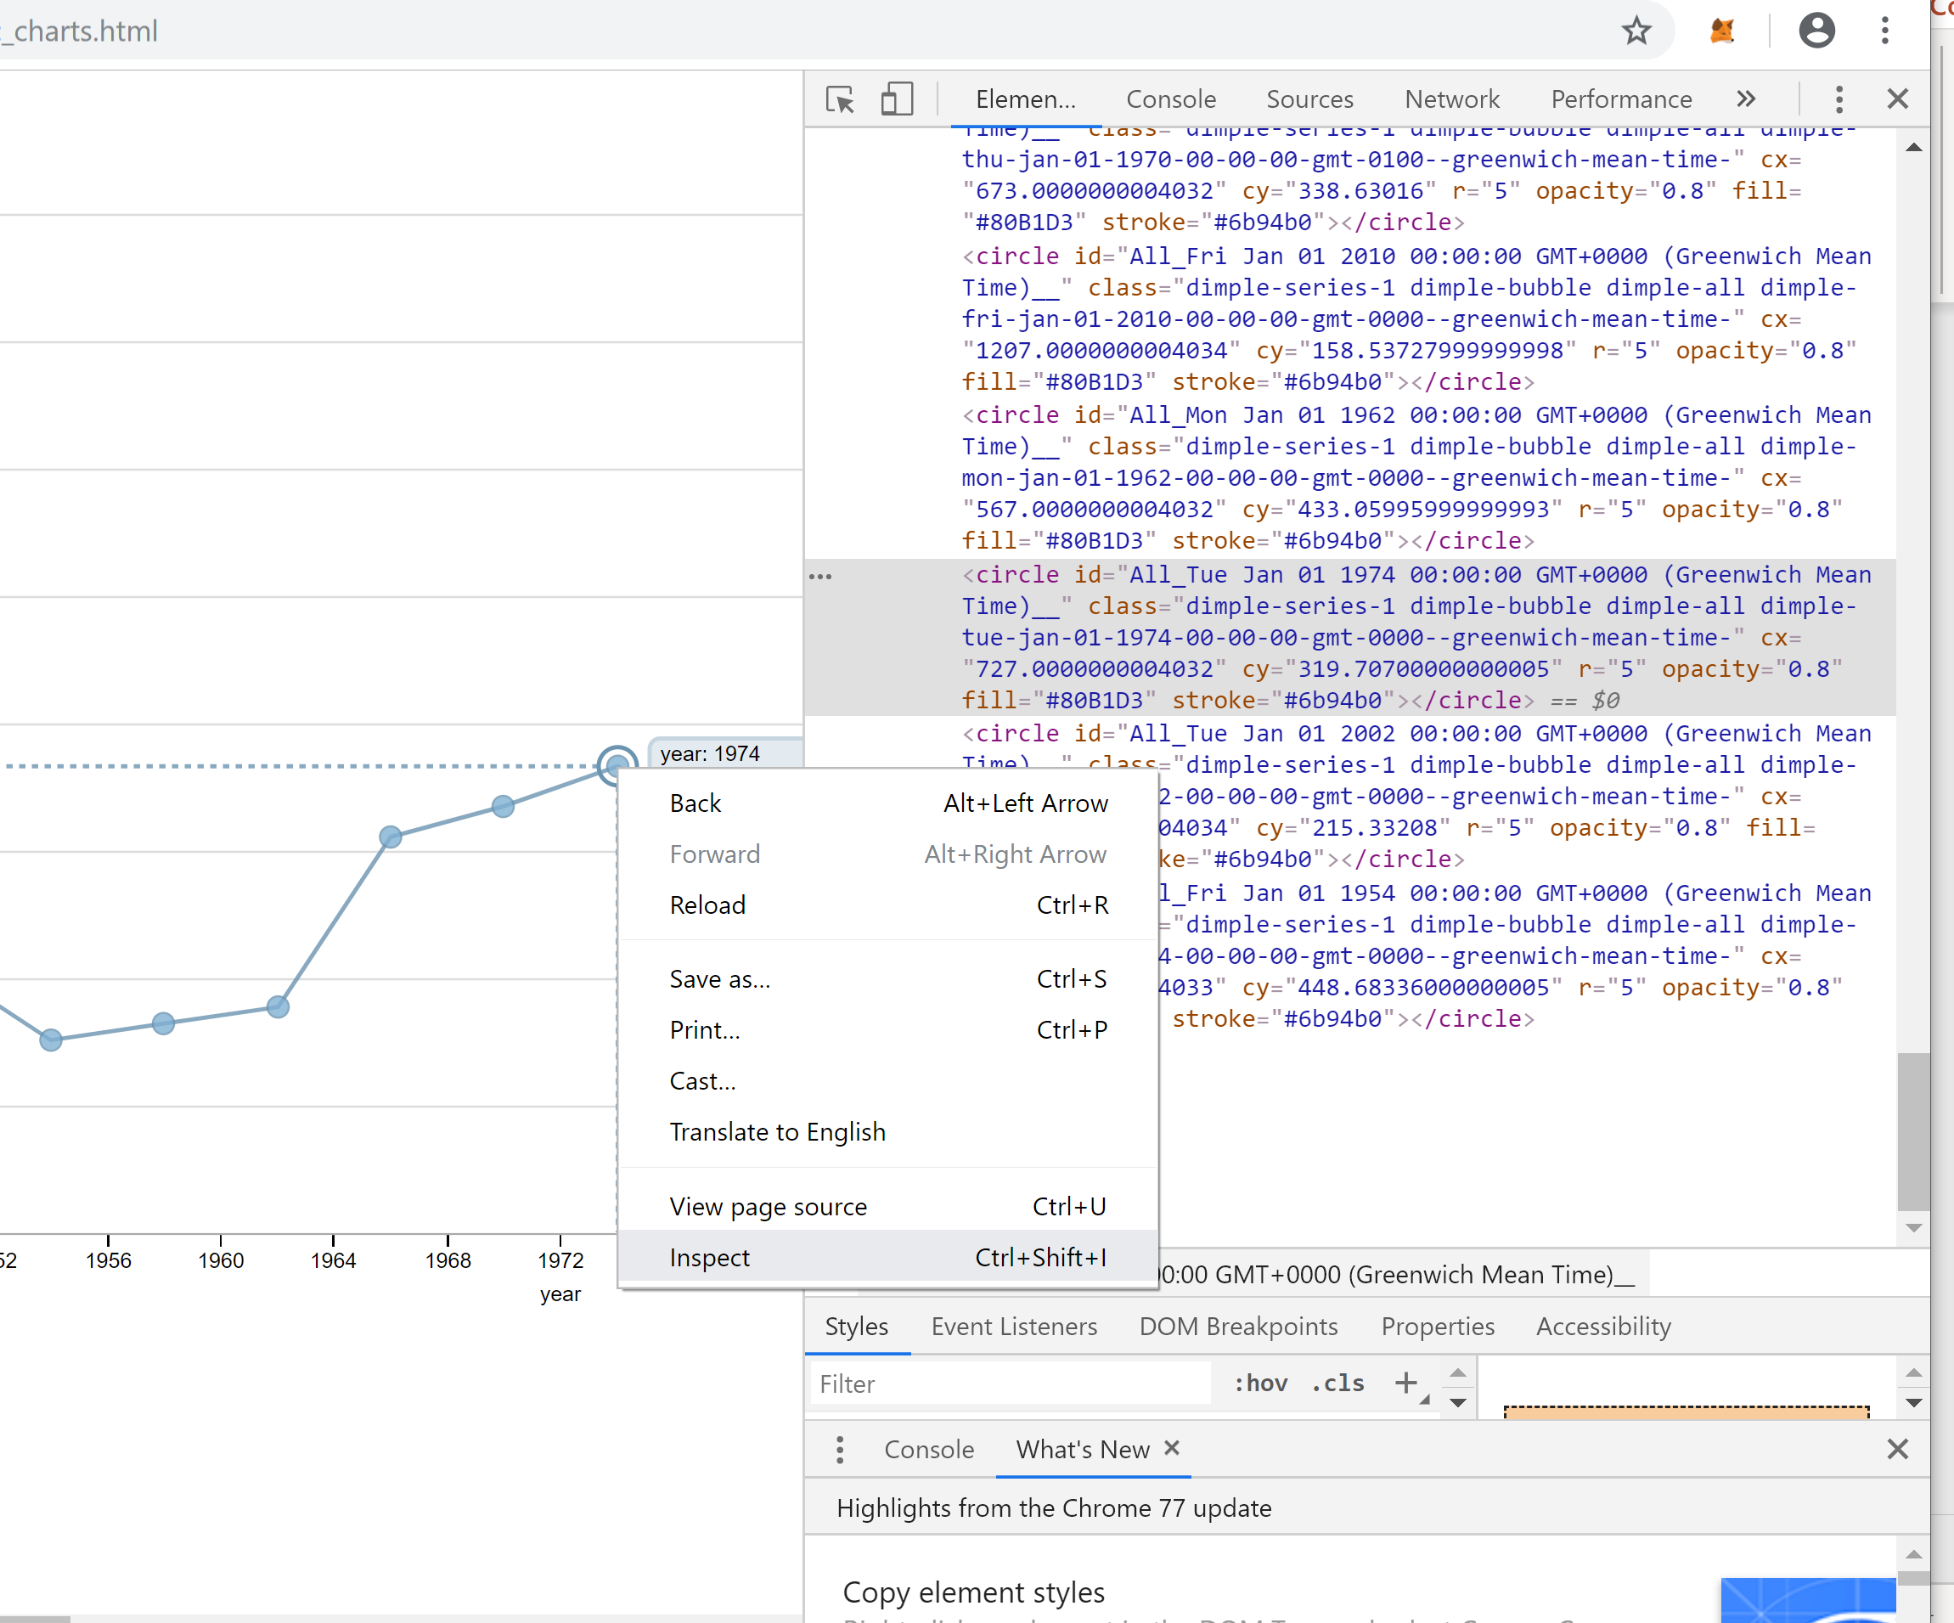
Line Plot + Scatter Plot Colour Circles
Left click on one of the bubbles and inspect the element
We can see there are several class labels associated with each bubble
We want to colour just the bubbles, there are two candidate class labels that could select the collection of bubbles
dimple-series-1
Dimple-bubble

Slide 27
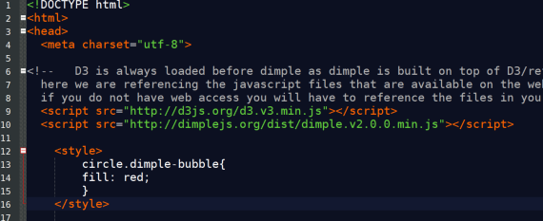
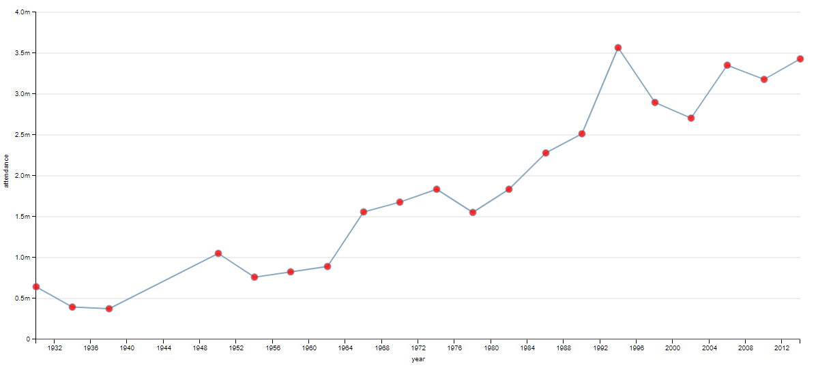
Line Plot + Scatter Plot Colour Circles
Open up a CSS style tag at the top of our HTML code
colour all bubble elements red
Does this improve things?

Slide 28
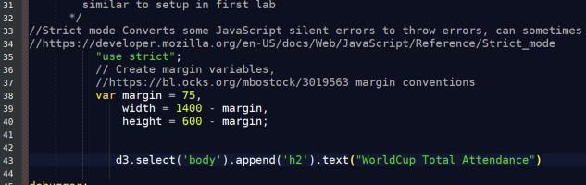
Add a Title
Now we have a lovely chart that we are very happy with!
Nobody else knows what we have charted!
At the top of the page we can add a header using D3 code we have seen already

Slide 29
Add a Title
Now we have a lovely chart that we are very happy with!
Nobody else knows what we have charted!
At the top of the page we can add a header using D3 code we have seen already

Slide 30
Add a Title
Where is the header?
How can we position it better?
Notes:
h2{ text-align:center; }

Slide 31
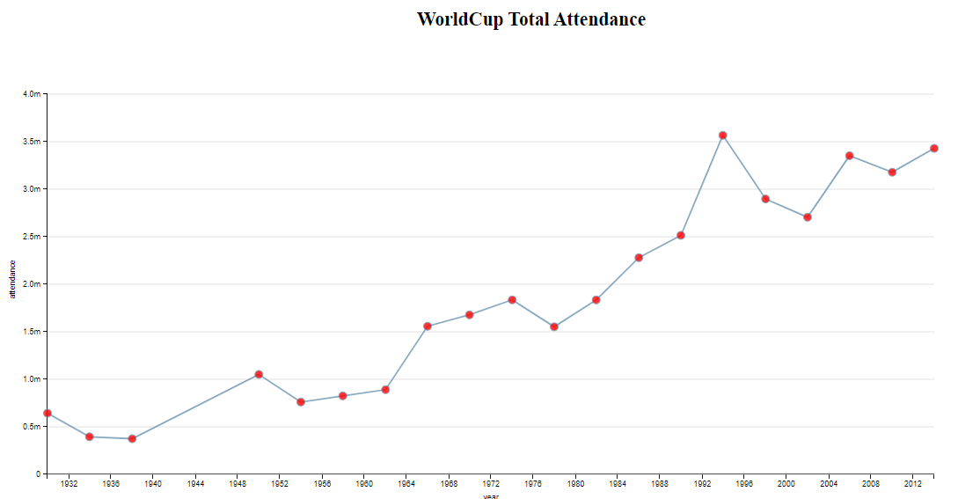
Congratulations! Your first Data Driven Document!
Notes:
h2{ text-align:center; }

Slide 32
Plotting Exploratory Data Analysis vs Sketching
EDA
Insights into data
Identify outliers or suspicious data points
Highlight structure/relationships
Done for you
Sketching
Visual Layout
Visual Encodings
General Design
Done for others

Slide 33
Summary
Started with a bar chart
Looked a bit off with narrow bars and did not represent the flow of time
Scatter plot
Better for time series but poor for highlighting the missing values
LineChart
Best for time series but not at highlighting individual events
Combo of line and Scatter Best of all Worlds!
Label your Charts
CSS is our friend!

